Slide 1


Leveraging Superhosts
Airbnb Chicago
SUSTAINABILITY AND PROFITABILITY
MGMT 683 - TEAM 13

Slide 2





Team
Santosh Pawan Kurada
Sathwik Kanukuntla
Soham Agarwal
Rohit Mittal
Varun Annapareddy

Slide 3
Key Focus Areas
Superhost Status Dynamics: We explored factors influencing Super host status across property types, its business benefits, and identified critical metrics like guest ratings, cancellation rates, and response times.
Performance Metrics Correlation: Our investigation revealed a strong link between Super host status and key performance indicators such as booking rates, occupancy, revenue, and guest satisfaction.
Improving Overall Ratings: We assessed factors impacting host ratings, emphasizing the importance of consistent quality, responsiveness, and property features.
Market Trends and Seasonality: The study examined market dynamics and seasonal trends, offering strategic insights for pricing and marketing.
Actionable Recommendations: We provided strategies for hosts to enhance listing appeal and service quality, along with guidance for Airbnb to support its hosting community.
Super Product Integration: Integrated machine learning insights with the GPT API, facilitating real-time, data-driven decision-making for hosts and Airbnb management.
Executive Summary
Objective: This project aims to enhance Airbnb listing performance by analyzing the dynamics of achieving Super host status. Utilizing advanced machine learning models and a rich panel dataset, we provide insights to improve guest experiences and boost overall platform success.
Outcome: Our comprehensive analysis and strategic recommendations aim to significantly improve host performance and guest satisfaction, reinforcing Airbnb's position in the market.
Notes:
Do my ratings matter?Is a 2 star rating bad? -> What major factors can help me increase my rating? ->

Slide 4

The Pinnacle of Popularity
A Verb Brand Status
from
“Let’s Book a Hotel”
to
“Let’s Airbnb”

Slide 5







Competition
Winner-take-all
Affordable
Offline
Transaction
Online
Transaction
Expensive

Slide 6
Who are they?
10k+
superhosts
as of 2018
Top-rated, most experienced hosts on Airbnb, committed to providing you with outstanding hospitality
Airbnb
Superhosts
Chicago
Superhost
Criteria
10+
stays
4.8+
overall rating
97.2
property rating
as of 2018
<1%
cancellation rate
90%
response rate
Notes:
They are Hosts who embody the highest standards of Airbnb hosting, consistently receiving top ratings, and their properties are the gold standard for what it means to be a part of Airbnb.
As of 2018, Chicago boasts over 10,000 active Superhosts. This figure isn’t just a number—it's a testament to the quality and dedication prevalent amongst our local Airbnb community. These hosts have maintained an impressive average property rating of 97.2%

Slide 7
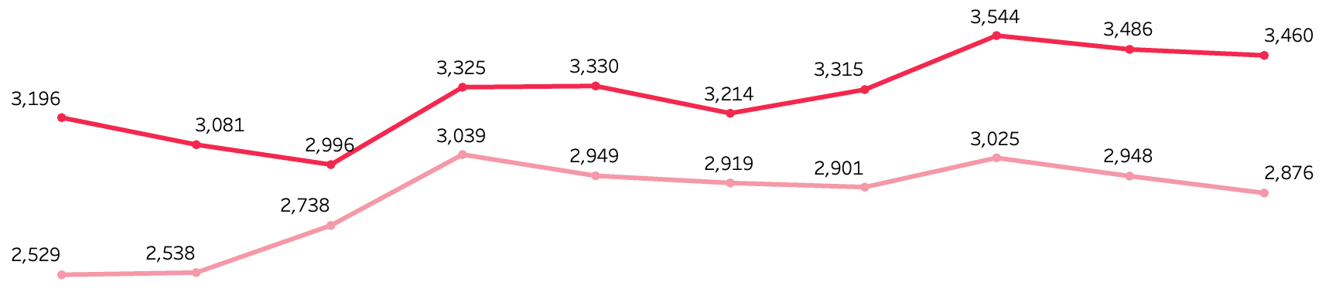
Revenue Comparison
superhosts
Host
vs
Superhost
hosts
2016 Q3
2017 Q1
2017 Q4
2018 Q1
2018 Q4
Notes:
The data shows that Superhosts consistently outperform regular hosts in terms of revenue. This is indicative of the value that guests place on the quality of service and experience provided by Superhosts. For example, in the third quarter of 2016, Superhosts earned, on average, $3,196 while regular hosts earned $2,529.
Deeping a little diver in to the data, we can observe the impact of seasonality on hosting revenue. However, despite these seasonal variations, Superhosts seem to mitigate the downturns more effectively, likely due to their established reputation and loyal customer base.

Slide 8


Let’s begin by breaking our analysis of Airbnb’ superhost program into two parts
What are the numbers telling us
What are numbers not telling us

Slide 9
….to lay it down
Am I ever going to be a superhost in this lifetime?
Am I going to lose my superhost status?
3 out of 4 superhost requirements are in my control, but how do I increase my average rating?
What are the numbers telling us
I want to be the CEO of Airbnb one day what more can I do to leverage the superhost program and maximise profitability?
What are numbers not telling us

Slide 10
What are the numbers telling us

Slide 11

Hosting to Superhosting
1
2
3
4
5
Exploratory Data Analysis
Data Pre Processing
Feature Selection
Modelling
Icing on the cake
Class
Imbalances
Manual removal of similar columns
Gradient Boosting
Logit
Regression
State of the art business insights generator to integrate in the Airbnb app
Identifying Missing Values, distributions, data types & data statistics
Feature Transformation
Removal of highly correlated variables
Polynomial Regression
Imputing missing values
Backward Regression
EDA
Superhost patterns - Geospatial pattern, Revenue trends
Removing outliers
Adaptive Lasso
Encoding Categorical values

Slide 12
Gradient Boosting
Prediction
97.3%
Accuracy
96.9% Precision
96.2% Recall
Model 1
Predicting superhost status
Problem
Am I ever going to be a superhost in this lifetime?
Logistic Regression
Interpretation
95.1%
Accuracy
86.7%
Precision
86.7%
Recall

Slide 13

Target: Predicting superhost status
Top 15 features from boosting affecting your chances
Features analyzed
-2.225%
cancellations past year
1.027%
superhost : host in a tract
rating_ave_pastYear
numCancel_pastYear
num_5_star_Rev_pastYear
superhost_change_gain_superhost
numReviews_pastYear
prev_rating_ave_pastYear
prev_num_5_star_Rev_pastYear
prop_5_StarReviews_pastYear
prev_prop_5_StarReviews_pastYear
prev_numCancel_pastYear
hostResponseAverage_pastYear
tract_superhosts_ratio
prev_numReviews_pastYear
tract_prev_superhosts_ratio
Number of Reviews
0.44%
avg. rating for past year in the previous period
2.59%
avg. rating past year
0.05%
responses in the past year
0.301%
reserved days in the past year

Slide 14
Business Implications
Quality of Service and Guest Satisfaction
Market Positioning and Competitive Environment
Operational Efficiency and Strategic Management
Notes:
Quality of Service and Guest Satisfaction:
Variables like average ratings (both past and current year) and host response numbers indicate the importance of maintaining high service quality and guest satisfaction. Consistently high ratings are crucial for attracting bookings and commanding premium prices, while active and balanced communication from the host enhances guest experience and encourages repeat business.
Market Positioning and Competitive Environment:
The ratio of superhosts in an area and the number of cancellations highlight the competitive nature of the market. A high concentration of top-rated hosts in an area necessitates maintaining excellent service standards to stay competitive. Simultaneously, a high number of cancellations may indicate reliability issues or unmet guest expectations, affecting the host's market positioning and reputation.
Operational Efficiency and Strategic Management:
The number of reserved days reflects the popularity and demand for the listing. High demand can lead to greater profitability, but it also necessitates careful management to prevent issues such as overbooking, property wear and tear, and potential decline in service quality. Balancing high occupancy with quality maintenance is key to sustainable business growth.

Slide 15
Gradient Boosting
Prediction
97.8% Accuracy
86.4%
Precision
Model 2
Superhost loss classifier
Problem
Am I going to lose my superhost status?
Logistic Regression
Interpretation
95.8%
Accuracy

Slide 16
Top 15 features from boosting affecting your chances
Target: Predicting loss of superhost status
Features analyzed
prev_numCancel_pastYear
prev_numReviews_pastYear
prev_rating_ave_pastYear
hostResponseNumber_pastYear
superhost_period_all
revenue
prev_hostResponseAverage_pastYear
numCancel_pastYear
tract_superhosts_ratio
prev_Number of Reviews
numReviews_pastYear
scrapes_in_period
tract_superhosts
prev_hostResponseNumber_pastYear
rating_ave_pastYear
0.756%
Cancellations in past 1 year
-0.073%
Annual Revenue
-0.575%
Number of Reviews past year
0.174%
Number of Super hosts in the tract

Slide 17
Business Implications
Ensure clear communication and guest engagement to avoid cancellations
High Revenue may help the host retain super host status
Focus on guest satisfaction for more reviews
Notes:
Guest Engagement and Satisfaction:
Variables Involved: prev_numReviews_pastYear, prev_rating_ave_pastYear, and prev_hostResponseAverage_pastYear.
Implication: These variables underscore the importance of guest engagement and satisfaction. A high number of reviews and good average ratings from the previous year indicate strong guest satisfaction, which can lead to repeat bookings and positive word-of-mouth. The average response rate of the host also plays a crucial role in maintaining communication with guests, reflecting on the host's commitment to customer service. This combination of reviews, ratings, and response rate is vital for building a strong reputation and attracting new guests.
Operational Efficiency and Revenue Generation:
Variables Involved: hostResponseNumber_pastYear and revenue.
Implication: The number of host responses and the generated revenue are indicators of operational efficiency and business success. Active communication with guests (reflected in the number of responses) is a key factor in ensuring guest satisfaction and handling issues proactively, potentially leading to higher revenue. Revenue is a direct measure of business performance, and its analysis can provide insights into pricing strategies, market demand, and the effectiveness of promotional activities.
Market Positioning and Risk Management:
Variable Involved: numCancel_pastYear.
Implication: The number of cancellations in the past year is a critical metric for understanding market positioning and assessing risk. High cancellation rates might indicate issues with the listing, such as misaligned guest expectations or problems with the property. It could also reflect broader market trends or competitive challenges. Managing this aspect is essential for maintaining a reliable and attractive service offering, minimizing revenue loss, and ensuring a stable market position.

Slide 18
Linear Regression
Prediction & Interpretation
Model 3
Predicting Average Rating
Problem
3 out 4 superhost requirements are in my control, but how do I increase my average rating?
61.5%
R2 Score
Notes:
completed stays
cancellation rate*
response rate
Overall rating of 4.8 or higher for your Airbnb listings
Although the R^2 squared isnt the highest, the coefficients tell us factors that influence the average rating.

Slide 19
Top 15 features from affecting your chances
Target: Predicting Host Rating
Features analyzed
-12.328%
Neighborhood in River North
-1.603%
Property Type - an apartment turned hotel.
Neighborhood_River North
rating_ave_pastYear
Neighborhood_Armour Square
prop_5_StarReviews_pastYear
prev_prop_5_StarReviews_pastYear
Neighborhood_Auburn Gresham
Neighborhood_Washington Heights
prev_rating_ave_pastYear
Neighborhood_Calumet Heights
Property Type_Room in aparthotel
Neighborhood_Back of the Yards
Neighborhood_Chatham
Zipcode_60621
Neighborhood_Belmont Cragin
prev_Rating Overall
6.255%
Avg rating of the past year
3.425%
previous proportion of 5 Star Reviews in the past year
3.190%
Being in the Neighborhood Auburn Gresham
2.296%
Being in the neighborhood Washington Height

Slide 20
Business Implications
Location Influence and Neighborhood Characteristics
Property Type and Guest Expectations
Quality of Service and Past Performance
Notes:
Location Influence and Neighborhood Characteristics:
Variables Involved: Neighborhood_River_North, Neighborhood_Auburn_Gresham, Neighborhood_Washington Height.
Implication: These variables highlight the significant impact of location on business performance. Different neighborhoods may have varied appeal to guests based on factors like safety, proximity to attractions, local amenities, and overall reputation. For instance, River North might attract a different demographic compared to Auburn Gresham or Washington Height. Understanding these neighborhood characteristics can guide targeted marketing strategies, appropriate pricing, and service offerings tailored to the expected guest profiles of each area.
Property Type and Guest Expectations:
Variable Involved: Property Type_Room in aparthotel.
Implication: The type of property being offered (in this case, a room in an aparthotel) sets certain expectations for guests regarding amenities, space, privacy, and service level. This influences the kind of guests attracted (e.g., business travelers, couples, tourists) and their satisfaction. Understanding how the property type aligns with guest needs and expectations is crucial for optimizing occupancy rates, pricing strategies, and guest experience.
Quality of Service and Past Performance:
Variables Involved: rating_ave_pastYear, prev_prop_5_StarReviews_pastYear.
Implication: These metrics are critical indicators of service quality and past performance. A high average rating and a substantial number of 5-star reviews from the previous year suggest a high level of guest satisfaction, which can be a strong selling point. This historical performance data can be leveraged in marketing efforts and can guide future improvements. It's important to maintain or enhance this level of service quality to ensure repeat business and positive word-of-mouth recommendations.

Slide 21

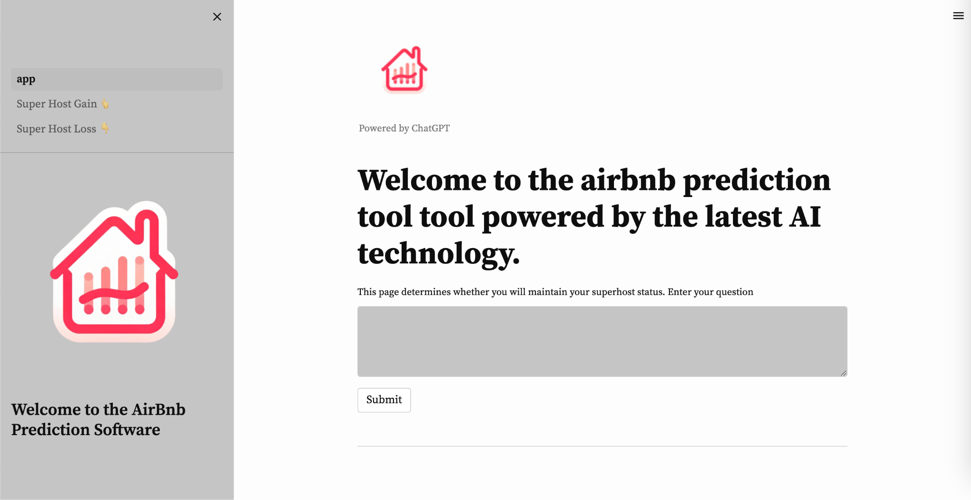
As a host, imagine you could know on how to become a superhost or where you’re going wrong!
Our website is a cutting-edge platform designed for Airbnb hosts, integrating three specialized machine learning models with the GPT API for enhanced business insights. Additionally, our site employs GPT's advanced AI capabilities to answer business-related questions, providing hosts with a comprehensive, data-driven approach to optimize their Airbnb operations.
Our “Super” Product
Click on this to access website
Notes:
Do my ratings matter?Is a 2 star rating bad? -> What major factors can help me increase my rating? ->

Slide 22
What are the numbers not telling us

Slide 23

Dynamic Metrics to become a superhost based on regional performance
Trade off between the motivation to become a Superhost and Exclusive Status of a Superhost
Optimize the Superhost Program by creating custom metrics so that hosts never miss an opportunity and Airbnb never misses an extra buck from the superhost premiums

Slide 24

Motivation
There are several psychological and cognitive factors that contribute to the decrease in motivation when faced with an overly difficult task:
1. Perceived competence
2. Goal discrepancy
3. Extrinsic vs. intrinsic motivation
Why Dynamic Criteria for Superhosts?
Exclusivity
An exclusive membership or exclusive status can lose its exclusivity in many ways:
1. Overgrowth
2. Accessibility
3. Loss of differentiation
Notes:
There are several psychological and cognitive factors that contribute to the decrease in motivation when faced with a very difficult task:
1. Perceived competence: When we encounter a task that seems overwhelmingly difficult, we often doubt our ability to complete it successfully. This low self-efficacy can lead to feelings of helplessness and hopelessness, making us less motivated to even attempt the task.
2. Goal discrepancy: Very difficult goals can create a large discrepancy between our current state and the desired outcome. This large gap can be discouraging and make the task feel insurmountable, leading to a decrease in motivation.
3. Extrinsic vs. intrinsic motivation: Difficult tasks often rely more on extrinsic motivation, like rewards or recognition, rather than intrinsic motivation, like enjoyment or interest. Extrinsic motivators tend to be less powerful and can fade quickly, especially when faced with challenges.
Sources - 1. Perceived competence:
Bandura, A. (1997). Self-efficacy: The exercise of control. W. H. Freeman and Company.
Schunk, D. H., & Pajares, F. (2002). Self-efficacy theory and conceptions of learning. In Educational psychology: An introduction (pp. 308-339). Routledge.
2. Goal discrepancy:
Locke, E. A., & Latham, G. P. (2002). Building a practically useful theory of goal setting and task motivation: A 35-year odyssey. American Psychologist, 57(9), 705.
Higgins, E. T. (1998). Promotion and prevention: Regulatory focus as a motivational principle. Advances in experimental social psychology, 30(1), 1-46.
3. Extrinsic vs. intrinsic motivation:
Deci, E. L., & Ryan, R. M. (1985). Intrinsic motivation and self-determination in human behavior. Plenum Press.
Ryan, R. M., & Deci, E. L. (2017). Self-determination theory: Basic psychological needs in motivation, development, and wellness. Guilford Publications.
An exclusive membership or exclusive status can lose its exclusivity in several ways:
1. Overgrowth: When the number of members or individuals with the status grows too large, it dilutes the feeling of exclusivity. What was once a small, intimate group becomes larger and less distinctive. Imagine a club that initially had 10 members, each feeling a sense of belonging to a special group. If the membership grows to 100, the feeling of exclusivity is likely to diminish.
2. Accessibility: If the criteria for joining or attaining the status become easier to meet, it loses its allure. Imagine a luxury brand that initially offered exclusive membership only to high-profile celebrities and CEOs. If they loosen the requirements to include anyone with a certain income level, the exclusivity fades.
3. Loss of differentiation: If other memberships or statuses emerge with similar benefits or privileges, the original exclusive option loses its unique appeal. Imagine a premium airline lounge that once offered unparalleled comfort and personalized service. If other airlines start offering similar experiences, the exclusivity of the first lounge fades.
Sources -
. Overgrowth:
Source: Schriver, K. (2012). The secret lives of clubs: Inside the rituals and rivalries of the world's most exclusive memberships. St. Martin's Press. (Chapter 3: The Perils of Popularity)
Quote: "Once a club reaches a certain size, it becomes difficult to maintain the same level of intimacy and exclusivity. New members dilute the sense of belonging, and the club can start to feel more like a generic social gathering place."
2. Accessibility:
Source: Veblen, T. (1899). The theory of the leisure class. Dover Publications. (Chapter 4: Conspicuous Consumption)
Quote: "As the goods or services associated with a particular status become more accessible, they lose their power to signal exclusivity. What was once a symbol of distinction for the wealthy elite becomes attainable by the masses, and its prestige diminishes."
3. Loss of differentiation:
Source: Thompson, C. J. (2005). Strategies for competing in global markets. Routledge. (Chapter 8: Branding and Differentiation)
Quote: "In today's competitive landscape, exclusivity alone is not enough to sustain a competitive advantage. Consumers are constantly bombarded with choices, and they are likely to gravitate towards brands or experiences that offer unique value propositions beyond mere exclusivity."

Slide 25

Representation Based on Qualitative Research
Motivation to become a superhost
Motivation
Exclusivity of a superhost
Exclusivity
Difficulty in Criteria
Notes:
There are several psychological and cognitive factors that contribute to the decrease in motivation when faced with a very difficult task:
1. Perceived competence: When we encounter a task that seems overwhelmingly difficult, we often doubt our ability to complete it successfully. This low self-efficacy can lead to feelings of helplessness and hopelessness, making us less motivated to even attempt the task.
2. Goal discrepancy: Very difficult goals can create a large discrepancy between our current state and the desired outcome. This large gap can be discouraging and make the task feel insurmountable, leading to a decrease in motivation.
3. Extrinsic vs. intrinsic motivation: Difficult tasks often rely more on extrinsic motivation, like rewards or recognition, rather than intrinsic motivation, like enjoyment or interest. Extrinsic motivators tend to be less powerful and can fade quickly, especially when faced with challenges.
Sources - 1. Perceived competence:
Bandura, A. (1997). Self-efficacy: The exercise of control. W. H. Freeman and Company.
Schunk, D. H., & Pajares, F. (2002). Self-efficacy theory and conceptions of learning. In Educational psychology: An introduction (pp. 308-339). Routledge.
2. Goal discrepancy:
Locke, E. A., & Latham, G. P. (2002). Building a practically useful theory of goal setting and task motivation: A 35-year odyssey. American Psychologist, 57(9), 705.
Higgins, E. T. (1998). Promotion and prevention: Regulatory focus as a motivational principle. Advances in experimental social psychology, 30(1), 1-46.
3. Extrinsic vs. intrinsic motivation:
Deci, E. L., & Ryan, R. M. (1985). Intrinsic motivation and self-determination in human behavior. Plenum Press.
Ryan, R. M., & Deci, E. L. (2017). Self-determination theory: Basic psychological needs in motivation, development, and wellness. Guilford Publications.
An exclusive membership or exclusive status can lose its exclusivity in several ways:
1. Overgrowth: When the number of members or individuals with the status grows too large, it dilutes the feeling of exclusivity. What was once a small, intimate group becomes larger and less distinctive. Imagine a club that initially had 10 members, each feeling a sense of belonging to a special group. If the membership grows to 100, the feeling of exclusivity is likely to diminish.
2. Accessibility: If the criteria for joining or attaining the status become easier to meet, it loses its allure. Imagine a luxury brand that initially offered exclusive membership only to high-profile celebrities and CEOs. If they loosen the requirements to include anyone with a certain income level, the exclusivity fades.
3. Loss of differentiation: If other memberships or statuses emerge with similar benefits or privileges, the original exclusive option loses its unique appeal. Imagine a premium airline lounge that once offered unparalleled comfort and personalized service. If other airlines start offering similar experiences, the exclusivity of the first lounge fades.
Sources -
. Overgrowth:
Source: Schriver, K. (2012). The secret lives of clubs: Inside the rituals and rivalries of the world's most exclusive memberships. St. Martin's Press. (Chapter 3: The Perils of Popularity)
Quote: "Once a club reaches a certain size, it becomes difficult to maintain the same level of intimacy and exclusivity. New members dilute the sense of belonging, and the club can start to feel more like a generic social gathering place."
2. Accessibility:
Source: Veblen, T. (1899). The theory of the leisure class. Dover Publications. (Chapter 4: Conspicuous Consumption)
Quote: "As the goods or services associated with a particular status become more accessible, they lose their power to signal exclusivity. What was once a symbol of distinction for the wealthy elite becomes attainable by the masses, and its prestige diminishes."
3. Loss of differentiation:
Source: Thompson, C. J. (2005). Strategies for competing in global markets. Routledge. (Chapter 8: Branding and Differentiation)
Quote: "In today's competitive landscape, exclusivity alone is not enough to sustain a competitive advantage. Consumers are constantly bombarded with choices, and they are likely to gravitate towards brands or experiences that offer unique value propositions beyond mere exclusivity."

Slide 26

Airbnb Certified Property Management Agencies
Leveraging a hidden player in the value chain
Increase your odds of getting perks for a property being managed by a superhost!
Notes:
As we navigate the evolving landscape of the shared economy, Airbnb can take proactive step by certifying property management agencies. Often, these agencies the unseen engines keep the Airbnb ecosystem running smoothly. By recognizing and certifying these agencies, Airbnb is leveraging these hidden players to reinforce and control the value chain from end to end.
The certification process for property management agencies creates a standardized level of service and quality. It translates into a more consistent and reliable experience for guests, which is crucial for Airbnb's brand reputation. In the next slide, I’ll be walking you through the value chain on how this is beneficial

Slide 27
Airbnb Value Chain
Consumers
Airbnb
Property Owners
Superhost Agencies
Money Flow
Product/ Services Flow
Consumers
Airbnb
Property Owners
Superhost Agencies
Information Flow
Property Owners
Superhost Agencies
Consumers
Airbnb
Notes:
Money flow:
Superhost agencies can help to optimize the pricing strategies for listings, potentially increasing revenue for property owners and, by extension, Airbnb, which takes a commission. Additionally, They can provide financial management services to property owners, ensuring a steady and optimized flow of income from consumers to hosts and then to agencies for their services.
Product/ Services:
Agencies ensure that the properties meet and exceed the standards expected by consumers, which is essential for retaining the trust and satisfaction. They can offer additional services such as professional cleaning, high-quality amenities, and local experiences, which can enhance the value of the product flowing back to consumers.
Information Flow:
These agencies facilitate a seamless flow of information by gathering feedback from consumers and communicating it to property owners and Airbnb, helping to improve service quality.

Slide 28
Thank you
Happy Hosting!
Notes:
Conclusion:
As consultants we hope to equip Airbnb and its hosts with data-driven strategies to enhance listing performance, increase revenue, and improve guest experiences. By leveraging insights from the analysis, Airbnb can also tailor its support and resources to areas where hosts need the most help in achieving Superhost status.

Slide 29
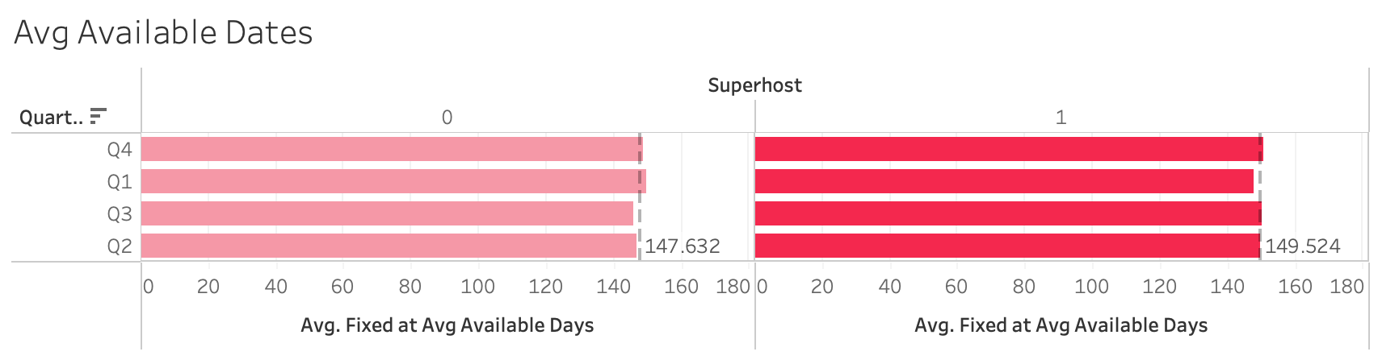
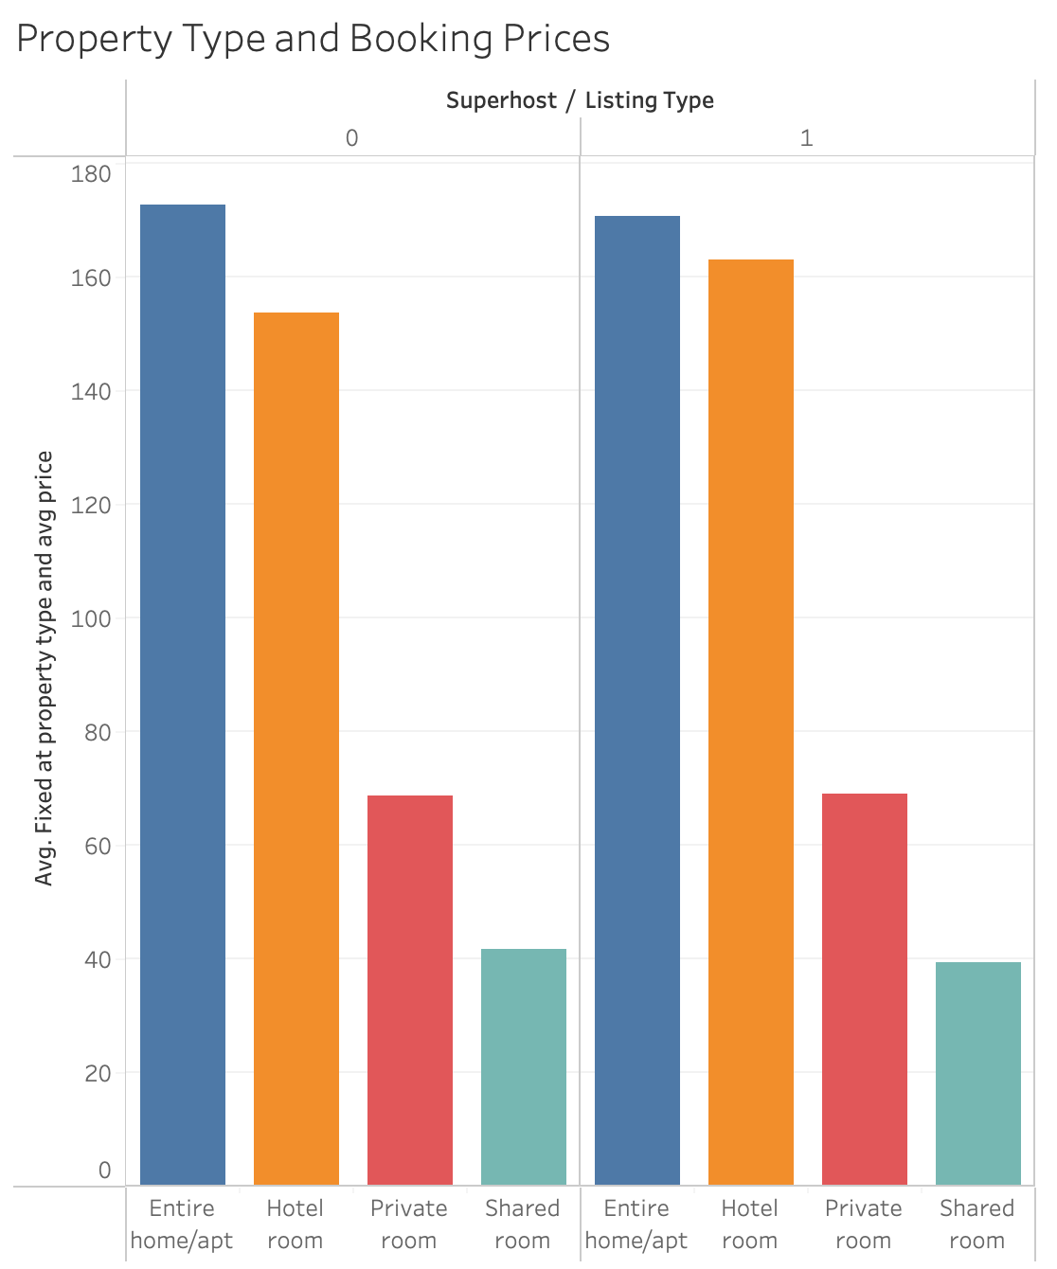
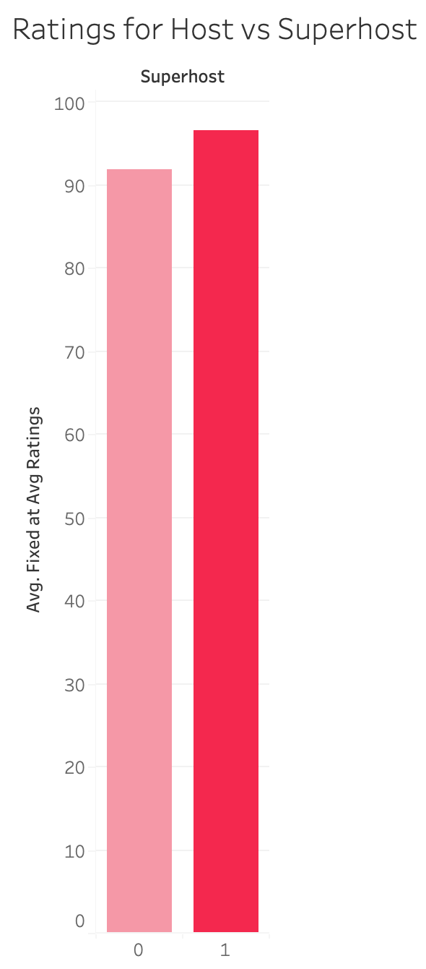
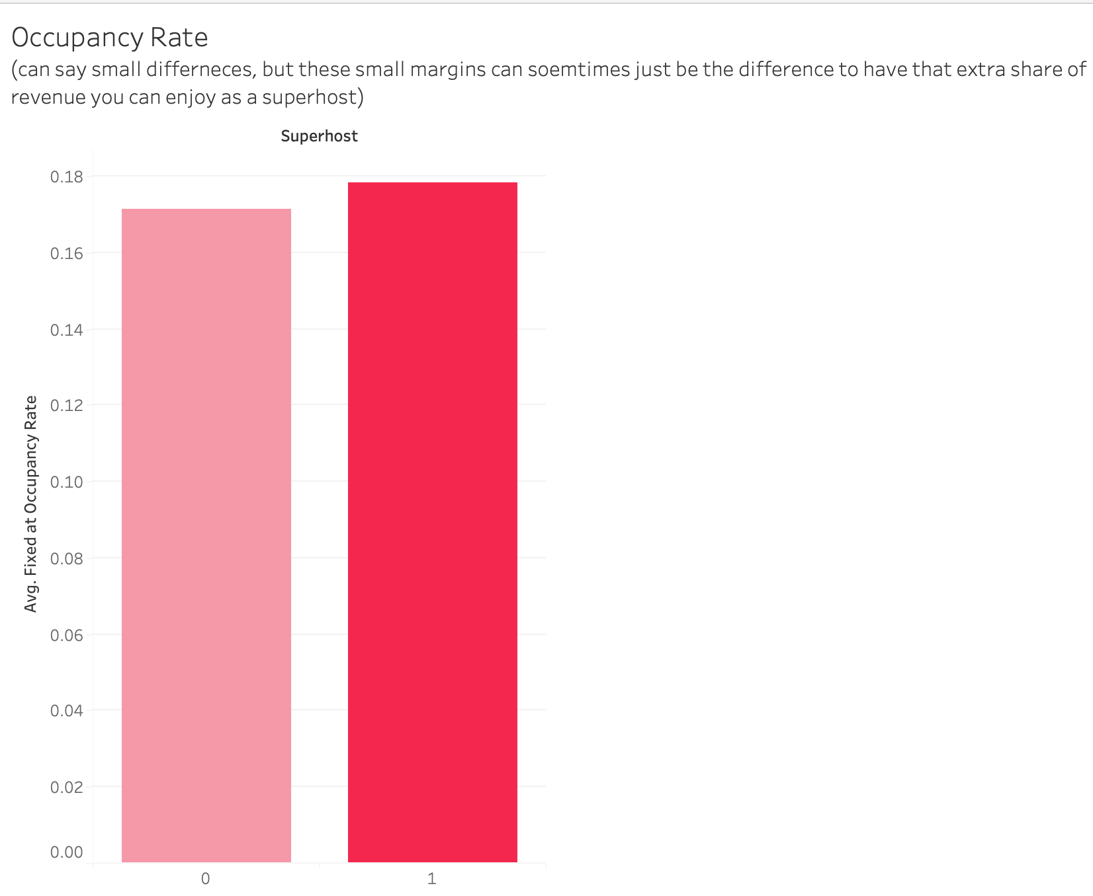
Superhost VS Host Analysis
0 – Host 1 - Superhost

Slide 30
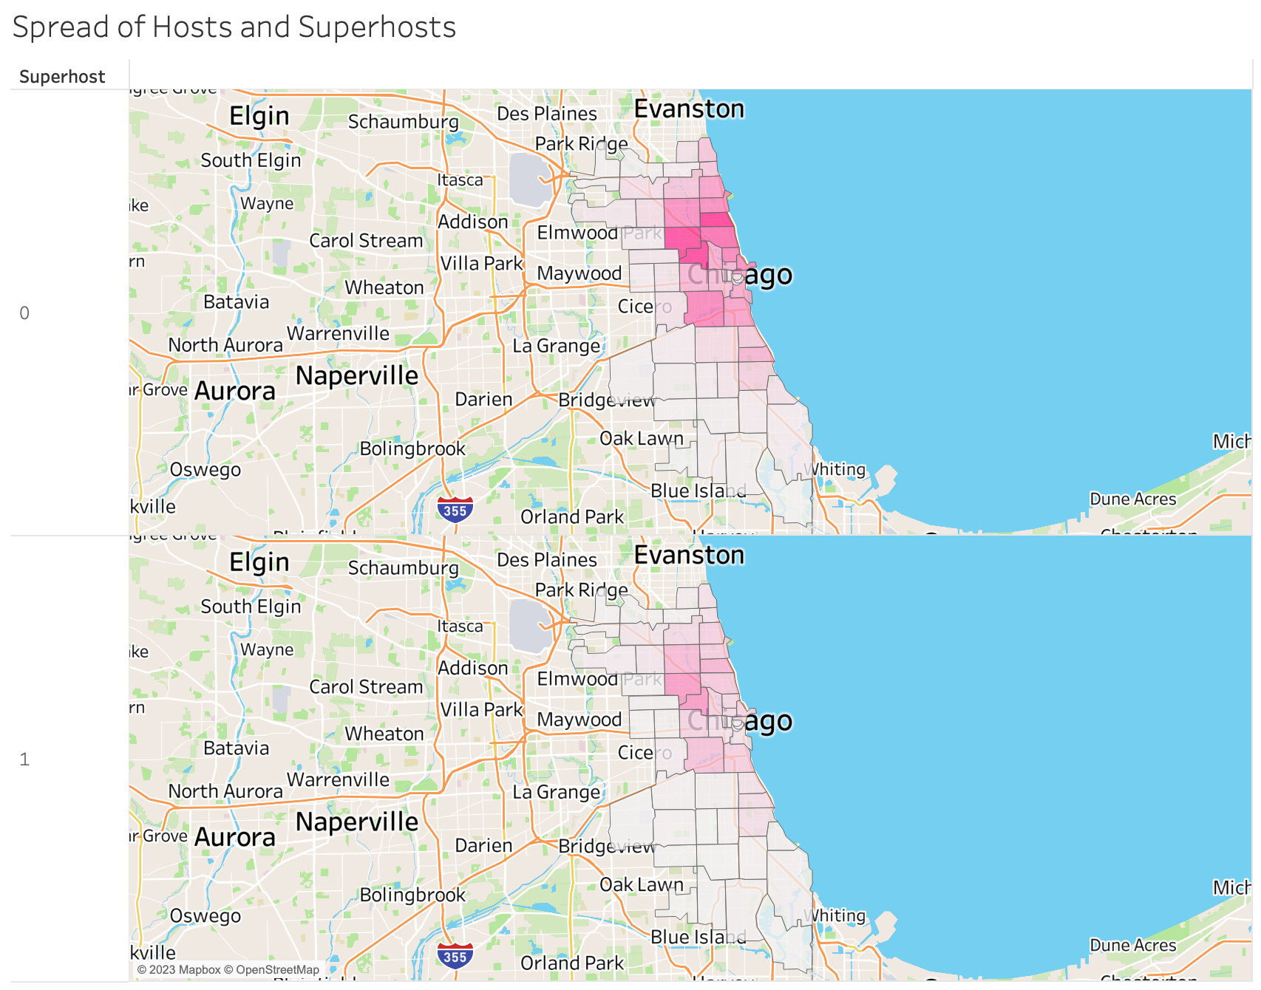
Geospatial Spread of Hosts and Superhosts
Host
Superhost

Slide 31
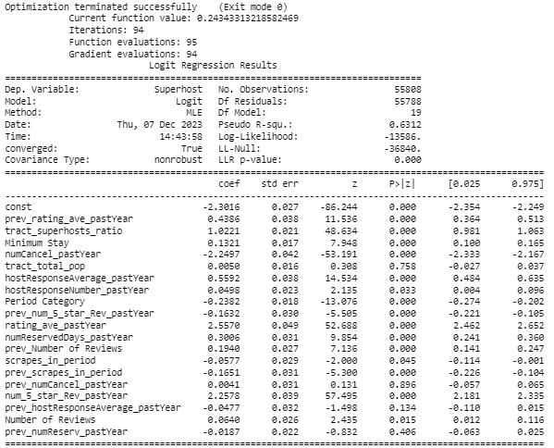
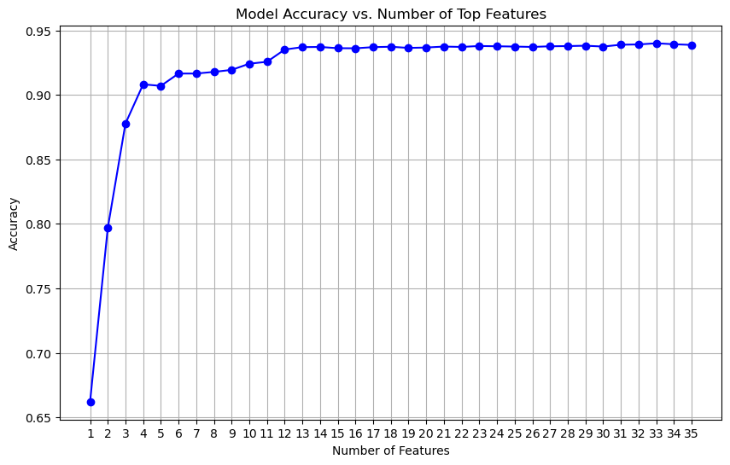
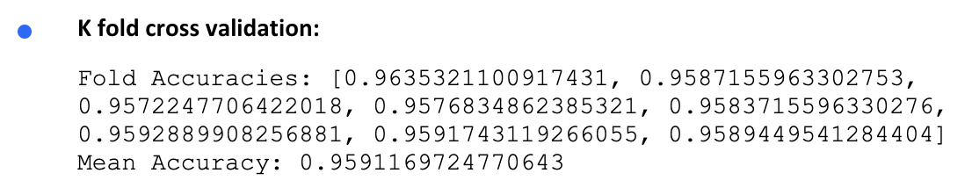
Model 1 Summary
Elbow Graph for feature selection

Slide 32
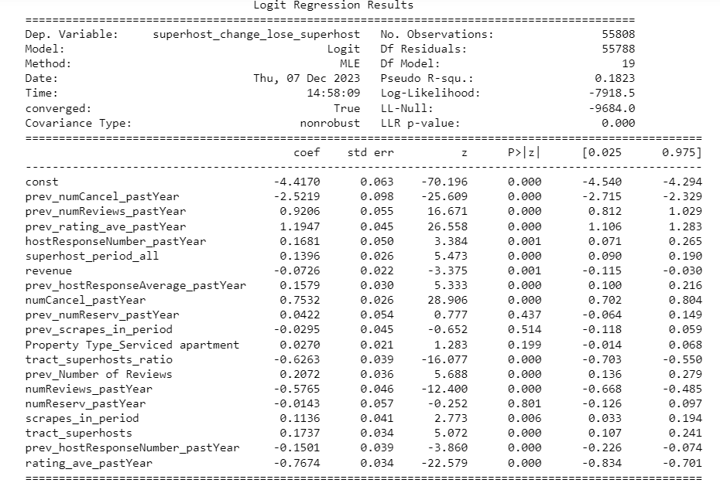
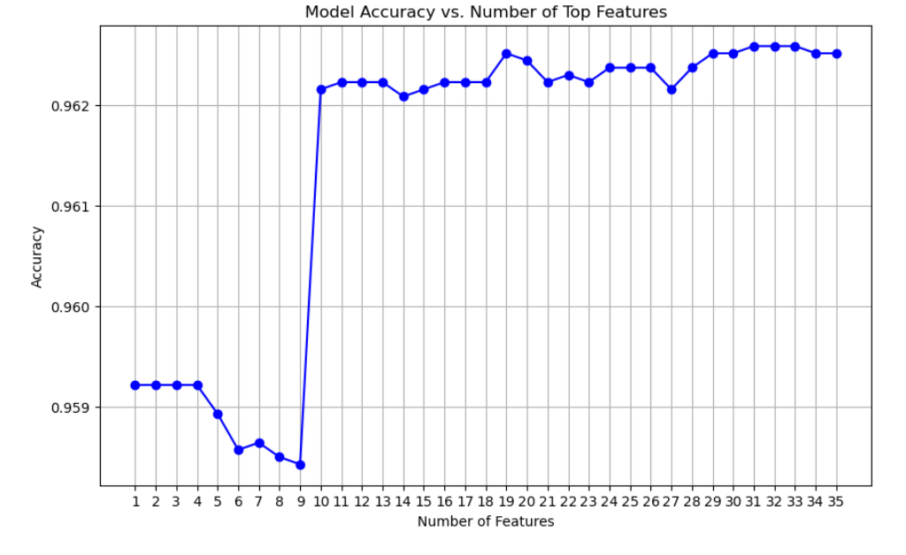
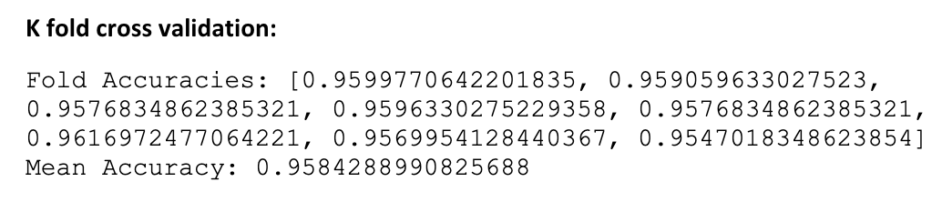
Model 2 Summary
Elbow Graph for feature selection

Slide 33
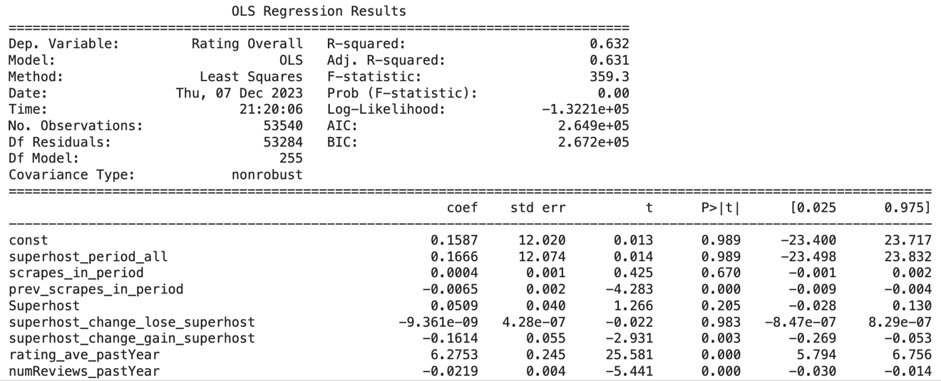
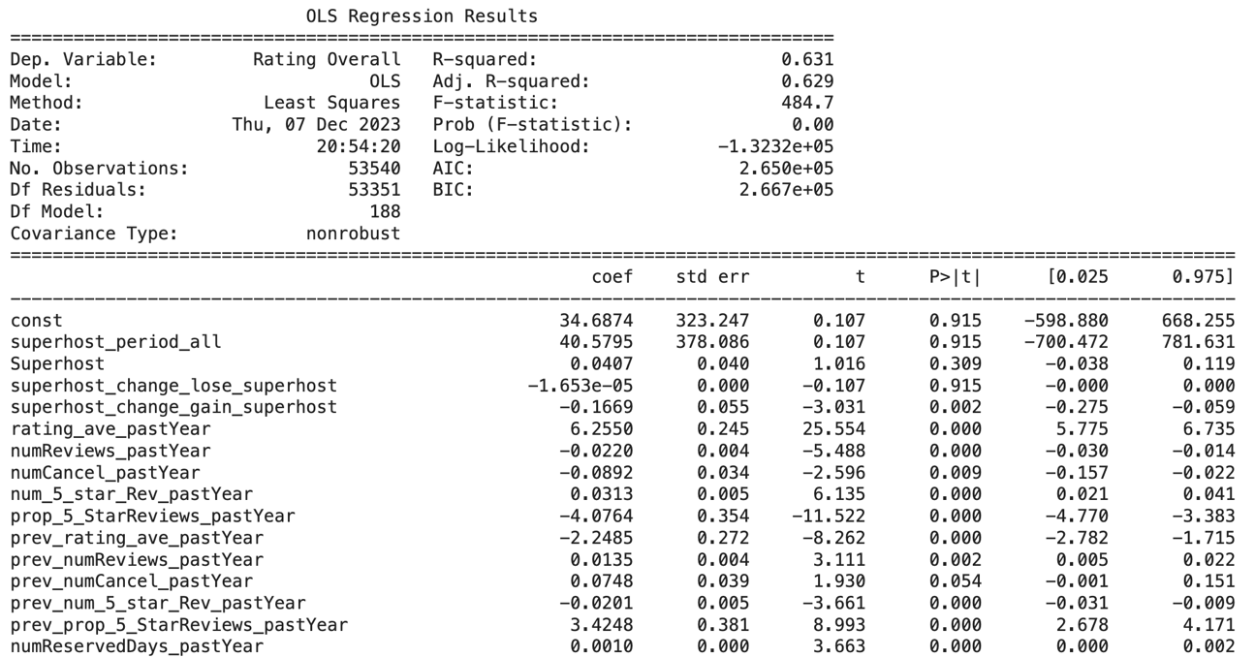
Model 3 Summary
Linear regression with Backward Selection Target: Rating
Linear regression Target: Rating

Slide 34
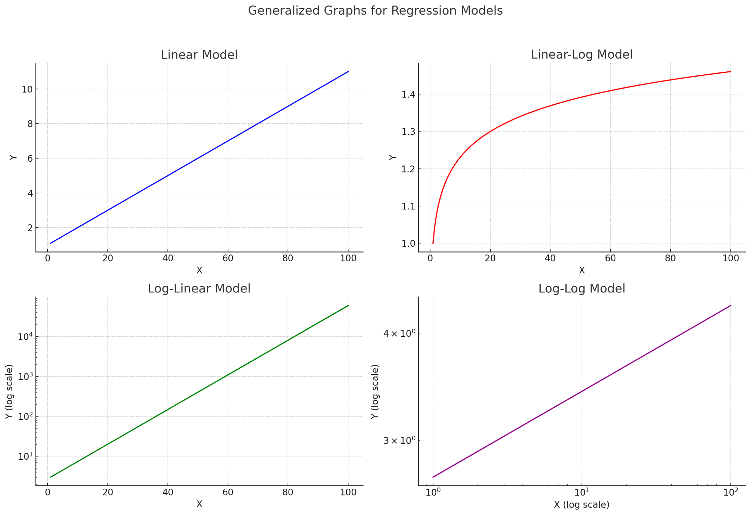
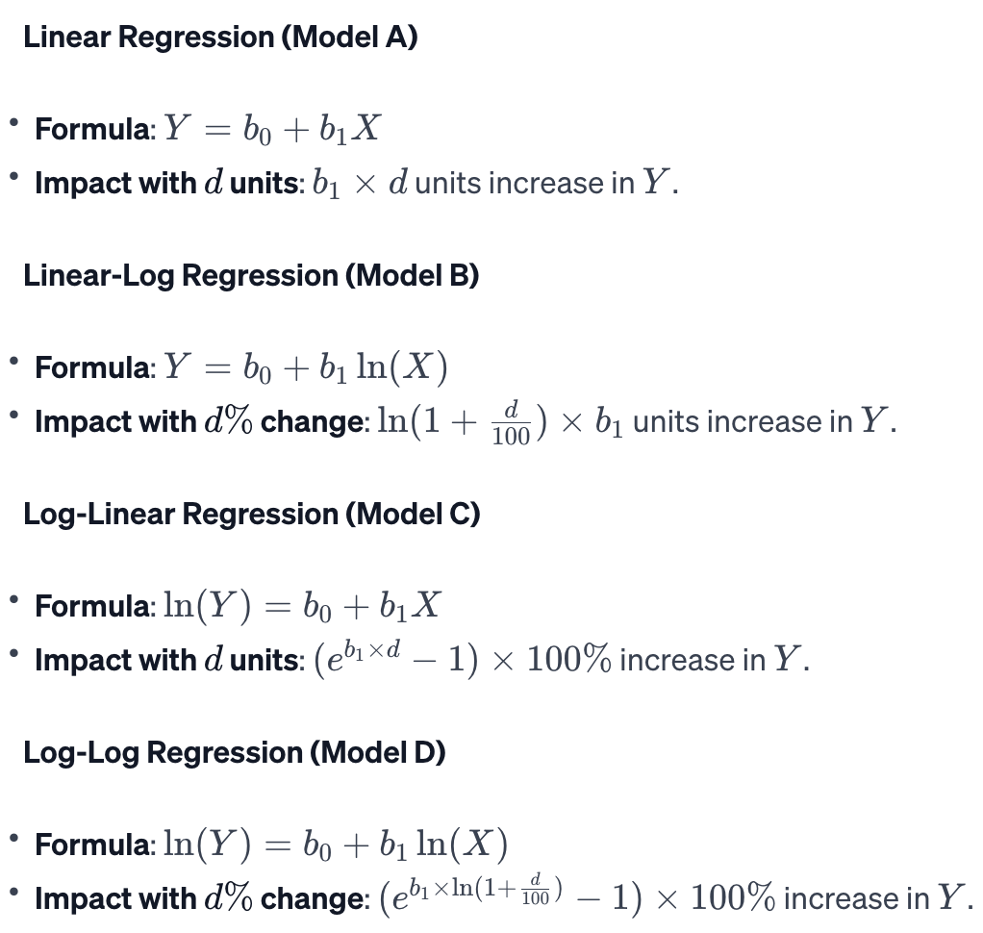
Interpreting Coefficients – Regression Models

Slide 35
Model Links
Superhost classifier:
https://drive.google.com/file/d/1jfziQv5-KHHcYnFBNj-kk1O01GXdQkvy/view?usp=sharing
Superhost loss predictor:
https://drive.google.com/file/d/19n6QO-nXUCa3CO-oSb5XdVWku33cuUyO/view?usp=sharing
Overall rating with Linear Regression and Adaptive Lasso:
https://drive.google.com/file/d/1FntfRQDY8vegqRjQIzbu9vx3gceML7ep/view?usp=sharing
Overall rating with Backward Selection:
https://drive.google.com/file/d/1A7S3dTpEtiKwY0s-Kv3HqM3o3026xFbY/view?usp=drive_link
Entire project link:
https://drive.google.com/drive/folders/1ghfZSWS389OFqudRu6anNp08G7A9AZi-?usp=sharing

Slide 36
References for recommendations
MOTIVATION
1. Perceived competence: Bandura, A. (1997). Self-efficacy: The exercise of control. W. H. Freeman and Company. Schunk, D. H., & Pajares, F. (2002). Self-efficacy theory and conceptions of learning. In Educational psychology: An introduction (pp. 308-339). Routledge.
2. Goal discrepancy: Locke, E. A., & Latham, G. P. (2002). Building a practically useful theory of goal setting and task motivation: A 35-year odyssey. American Psychologist, 57(9), 705.Higgins, E. T. (1998). Promotion and prevention: Regulatory focus as a motivational principle. Advances in experimental social psychology, 30(1), 1-46.
3. Extrinsic vs. intrinsic motivation: Deci, E. L., & Ryan, R. M. (1985). Intrinsic motivation and self-determination in human behavior. Plenum Press. Ryan, R. M., & Deci, E. L. (2017). Self-determination theory: Basic psychological needs in motivation, development, and wellness. Guilford Publications.
EXCLUSIVITY 1. Overgrowth: Source: Schriver, K. (2012). The secret lives of clubs: Inside the rituals and rivalries of the world's most exclusive memberships. St. Martin's Press. (Chapter 3: The Perils of Popularity)Quote: "Once a club reaches a certain size, it becomes difficult to maintain the same level of intimacy and exclusivity. New members dilute the sense of belonging, and the club can start to feel more like a generic social gathering place."
2. Accessibility: Source: Veblen, T. (1899). The theory of the leisure class. Dover Publications. (Chapter 4: Conspicuous Consumption)Quote: "As the goods or services associated with a particular status become more accessible, they lose their power to signal exclusivity. What was once a symbol of distinction for the wealthy elite becomes attainable by the masses, and its prestige diminishes."
3. Loss of differentiation: Source: Thompson, C. J. (2005). Strategies for competing in global markets. Routledge. (Chapter 8: Branding and Differentiation)Quote: "In today's competitive landscape, exclusivity alone is not enough to sustain a competitive advantage. Consumers are constantly bombarded with choices, and they are likely to gravitate towards brands or experiences that offer unique value propositions beyond mere exclusivity."

